Slide 1
What does the LEND CSETN really measure?
V.Eke (ICC, Durham University, UK)
L.Teodoro (BAER, NASA Ames)
D.Lawrence (JHU APL)
R.Elphic (NASA Ames)
W.Feldman (PSI, Tucson)
(See Eke et al, 2012, ApJ, 747, 6)

Slide 2
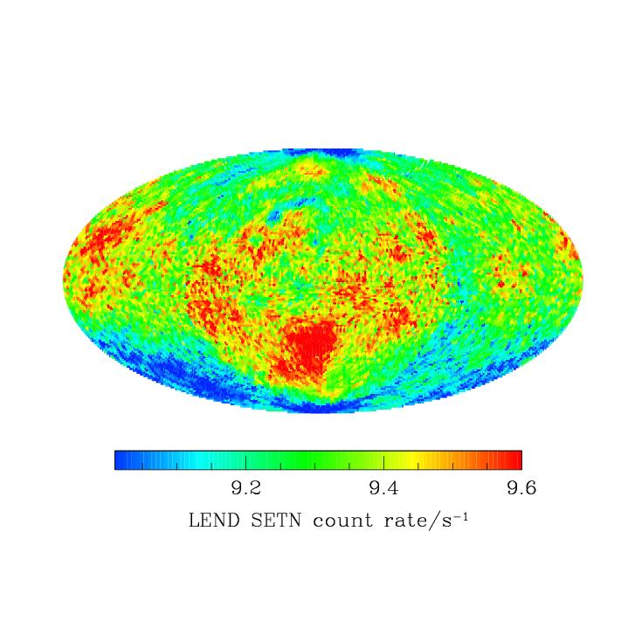
‘Omni-directional’ LEND

Slide 3
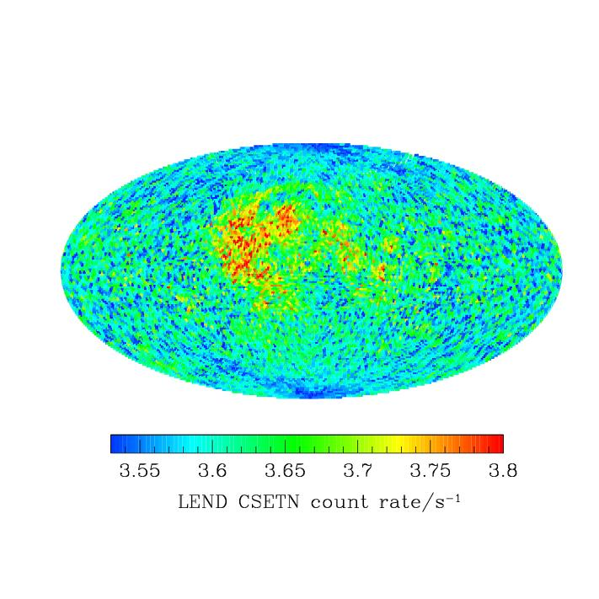
‘Omni-directional’ LEND
‘Collimated’ LEND

Slide 4
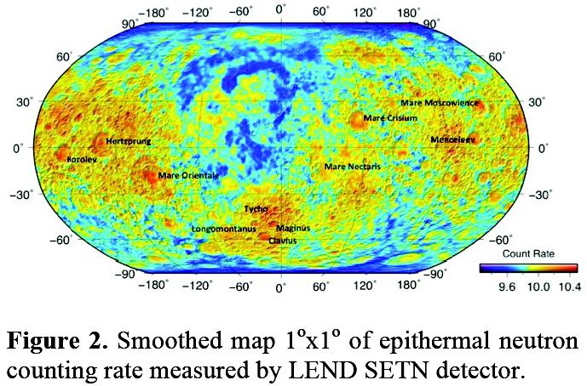
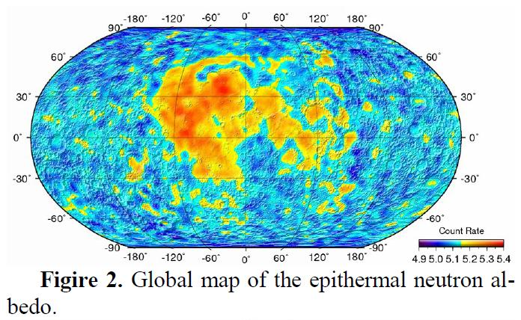
Litvak et al, 2012, LPSC
Sanin et al, 2011, LPSC

Slide 5
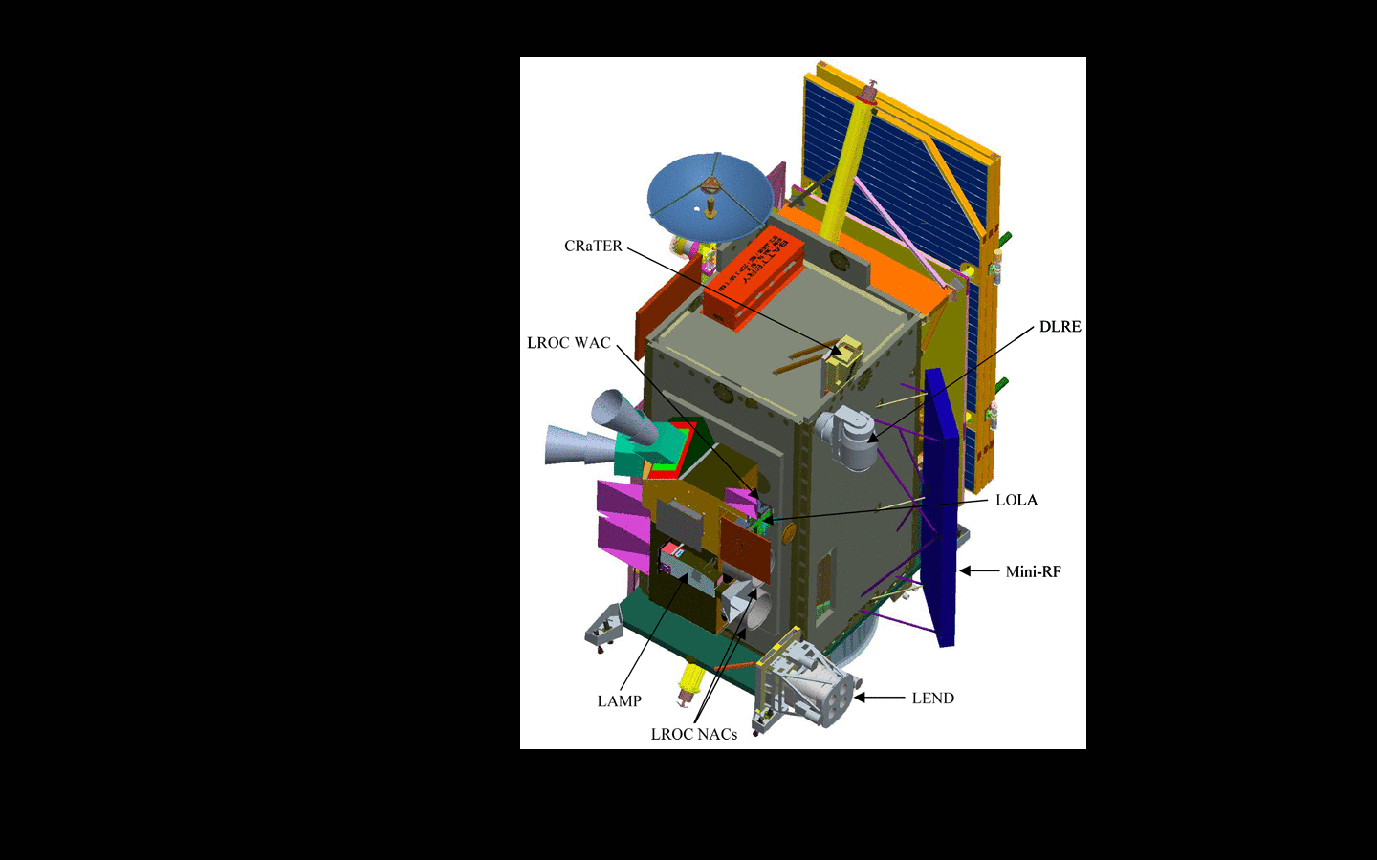
Lunar collimated
Lunar uncollimated
Spacecraft

Slide 6
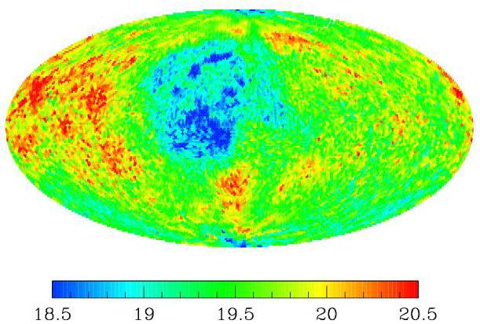
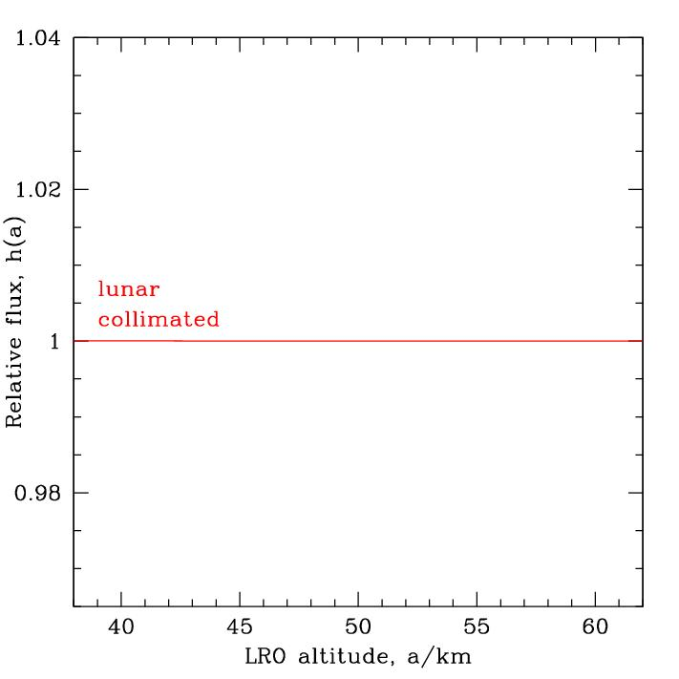

Slide 7
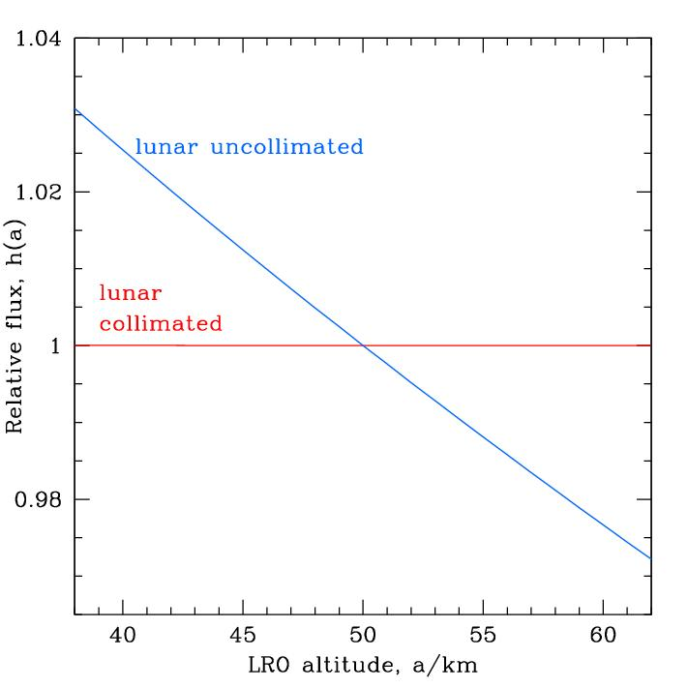
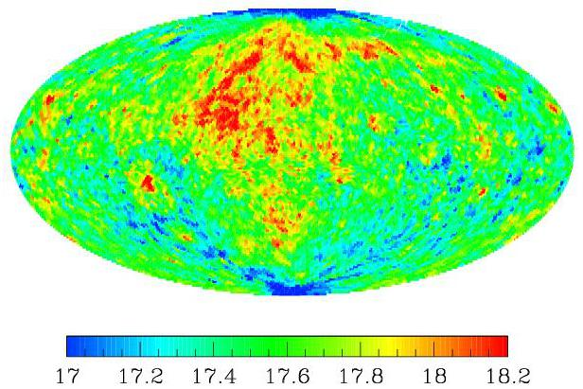

Slide 8
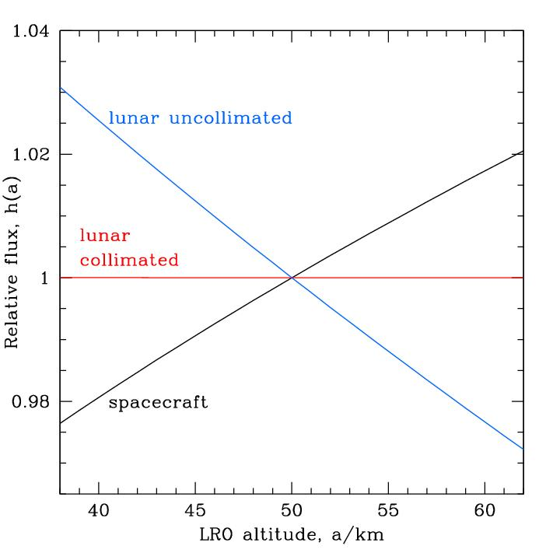
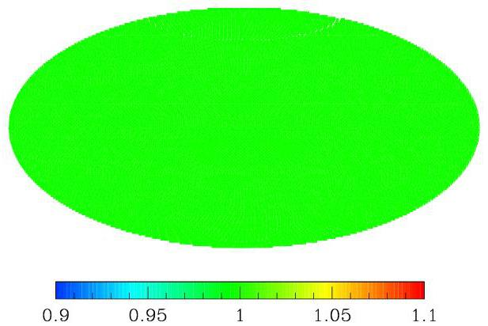

Slide 9
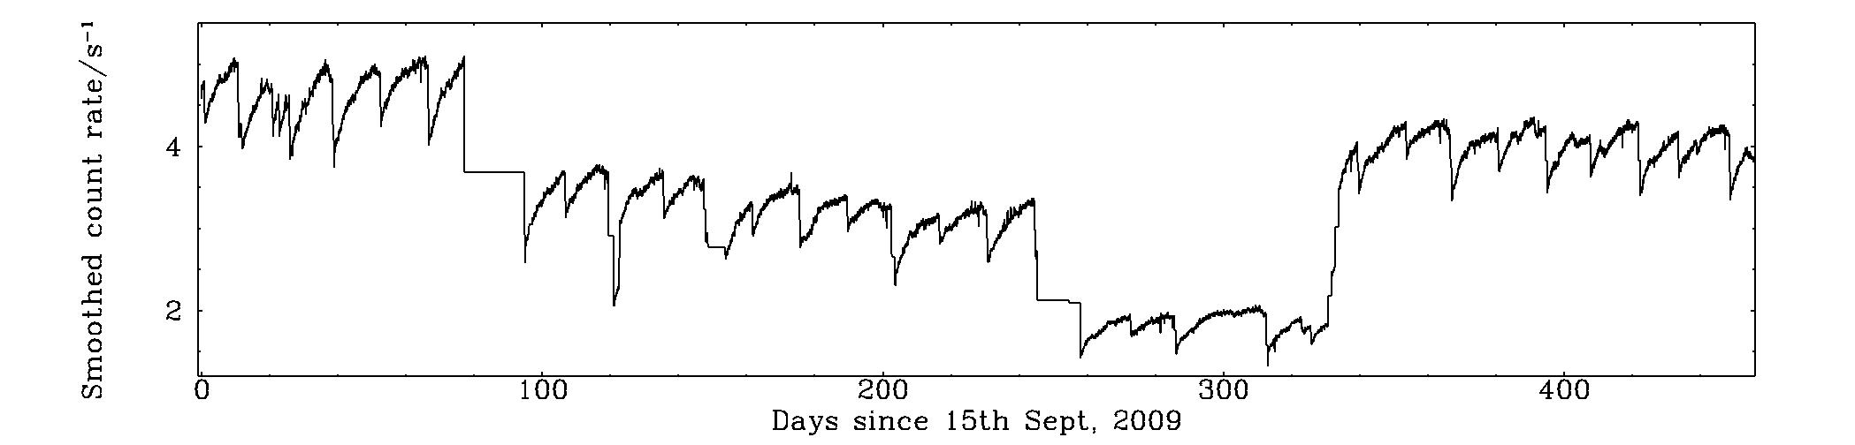
First 15 months of LEND CSETN data
Average count rate=3.6/s

Slide 10
Component fractions

Slide 11
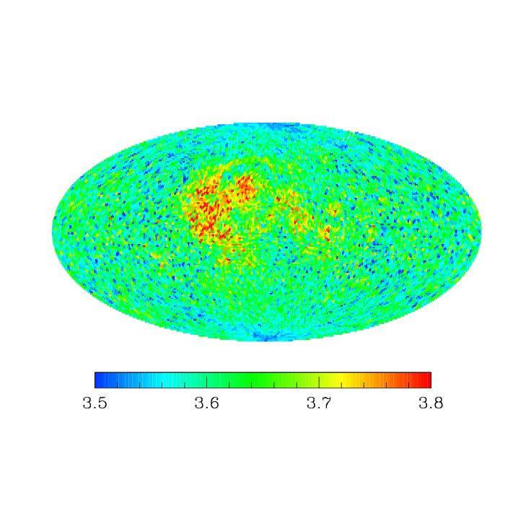
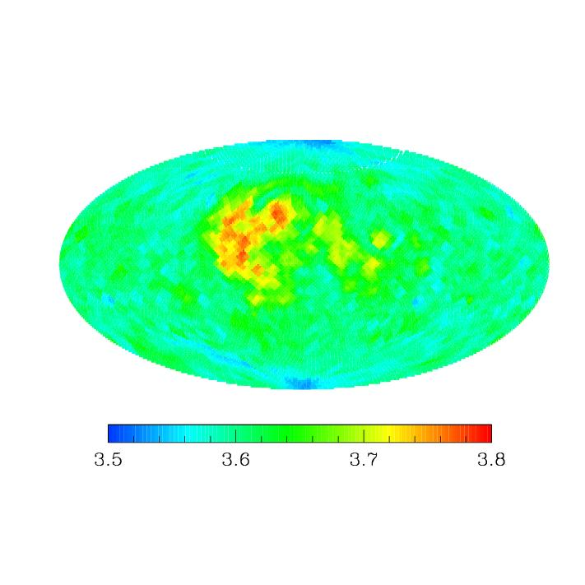
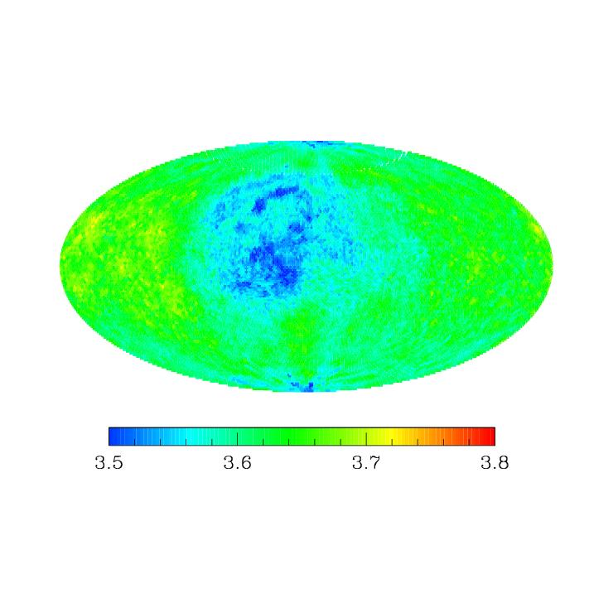
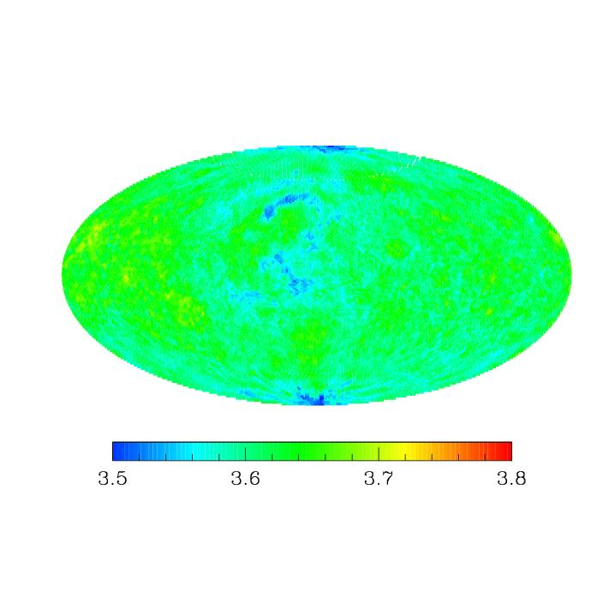
CSETN data
Most likely model
Mitrofanov et al 2010
Mitrofanov et al 2011

Slide 12
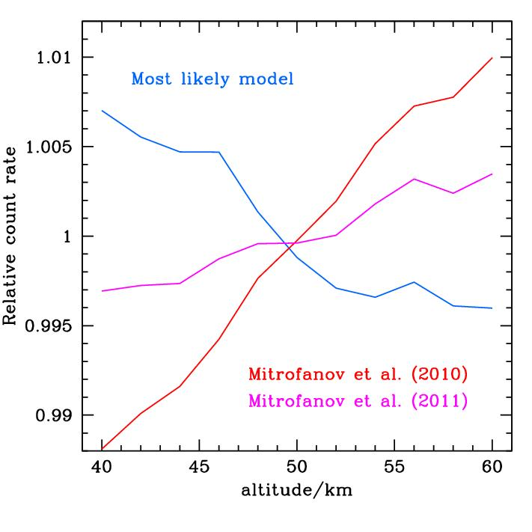

Slide 13
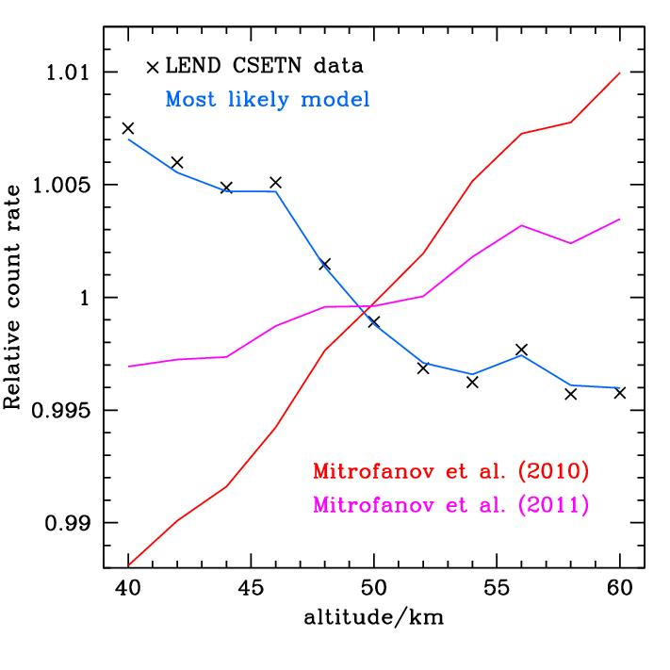

Slide 14
Conclusions
The LEND CSETN receives more than half of its counts from non-lunar sources
The lunar component is clearly dominated by uncollimated high energy epithermal (HEE) neutrons, in contrast to claims by the LEND team
The LEND SHEEN has produced the first lunar HEE map – this is the scientific product from this detector.

Slide 15
‘Omni-directional’ LEND
‘Collimated’ LEND

Slide 16
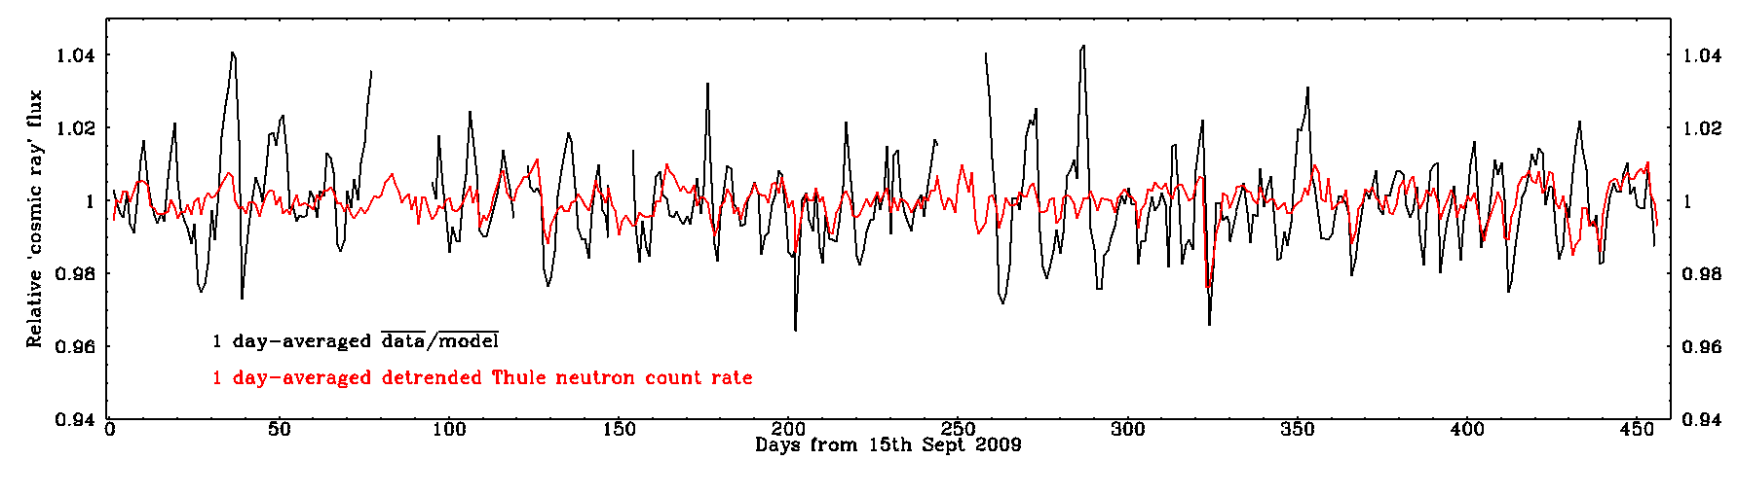
Verification with Earth-based neutron
detectors
Spearman correlation coefficient=0.38

Slide 17
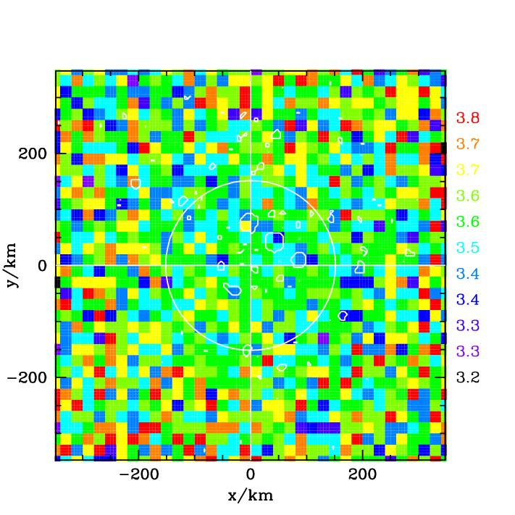

Slide 18
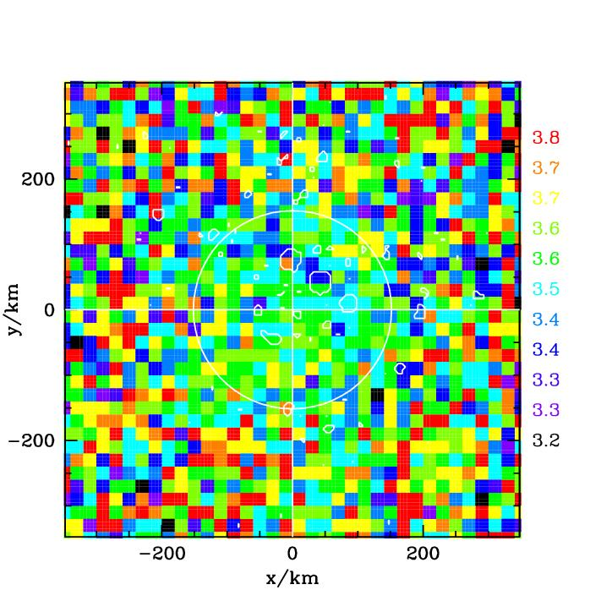

Slide 19
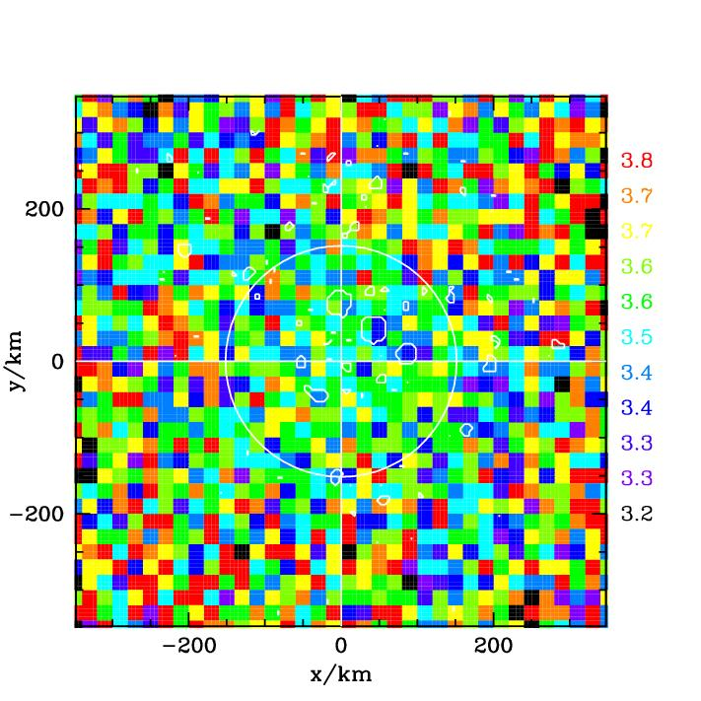

Slide 20
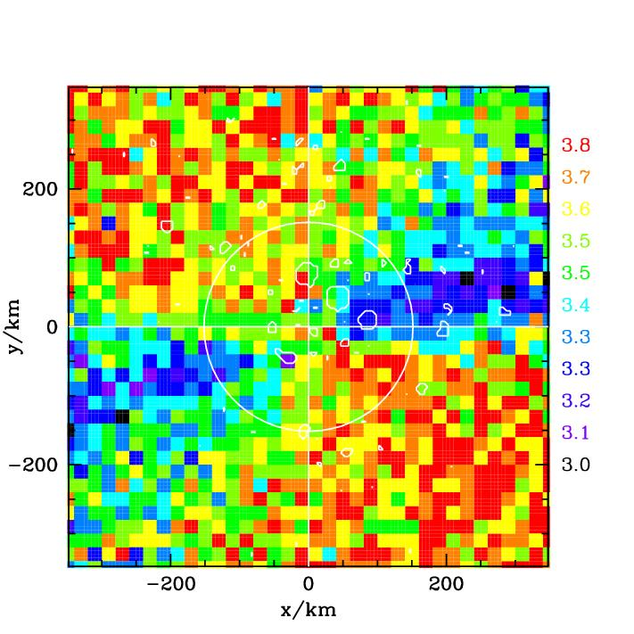

Slide 21
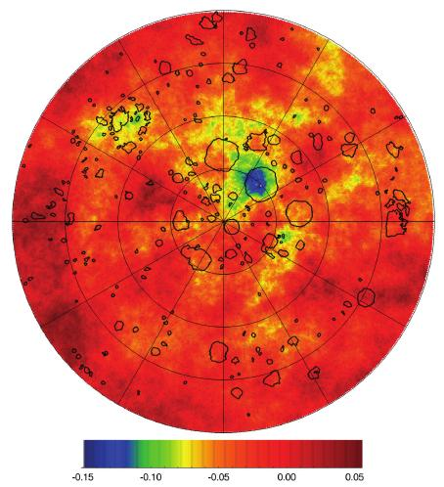
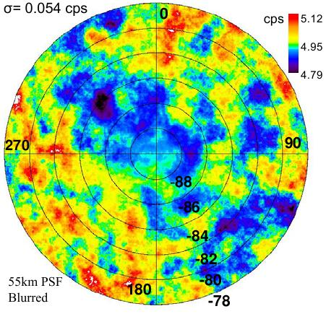
Boynton et al, 2010, LEAG Meeting
McClanahan et al, 2010, LPSC

Slide 22
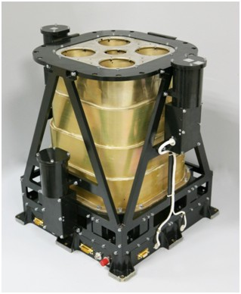
The LEND CSETN

